Slide 1


Slide 2
INTRODUCTION
This project examines whether recorded crime rates in Greece increased or decreased between 1993 and 2007.
01
Greece’s pattern is compared with the rest of Europe using crime rates per 100,000 inhabitants.
02
The crime data was downloaded from Eurostat, and the static visualizations were created using Python.
03

Slide 3
Dataset Overview
Period examined: 1993-2007
Focus: Greece’s crime trend compared with Europe
Metric used: crime rate per 100,000 inhabitants
Population data was used to make comparisons fair across countries and years.

Slide 4
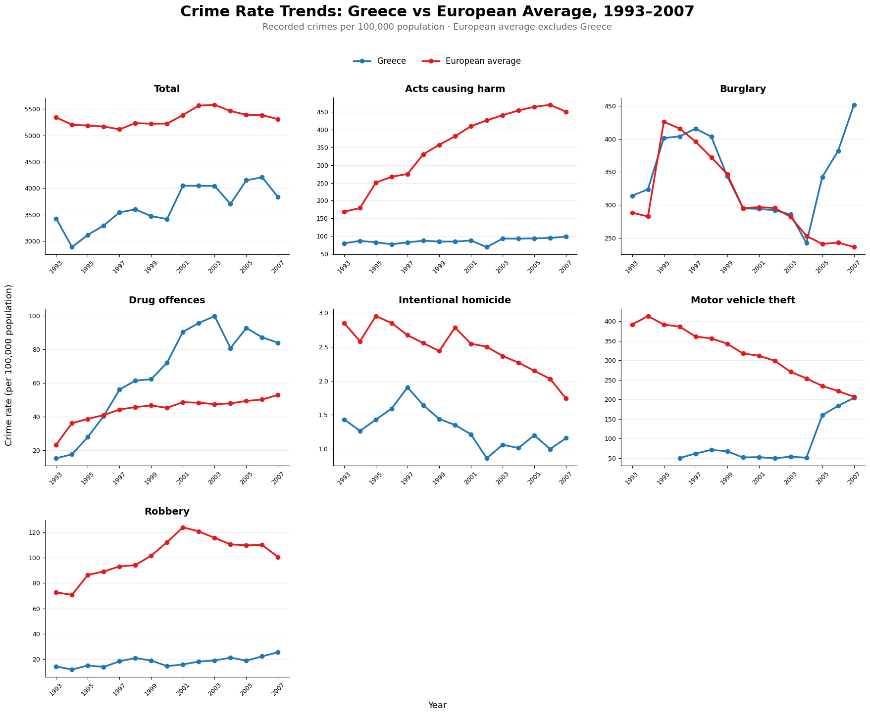
Greece vs European Average Total Crime Trend
Greece stayed below the European average in total recorded crime rate.
Total crime in Greece increased until around 2005, then declined in 2007.
The strongest increases in Greece appear in drug offences and burglary.

Slide 5
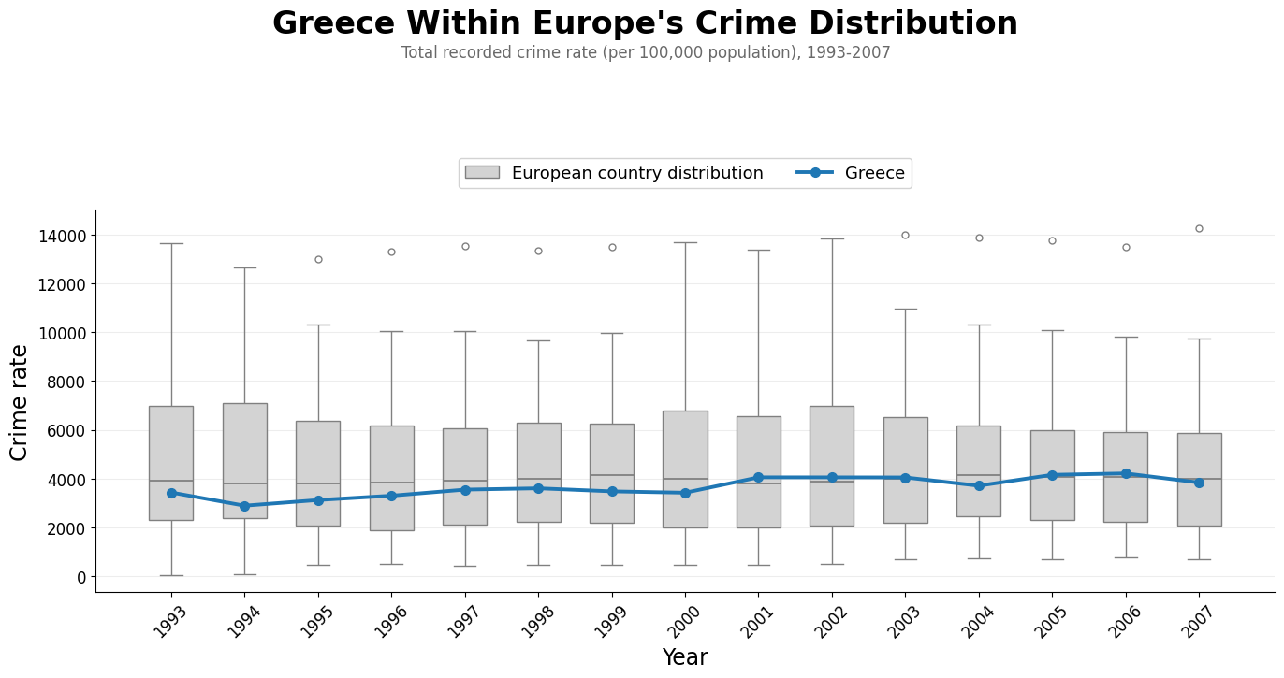
Greece Within Europe’s Crime Distribution
Greece followed a relatively stable path within Europe’s crime-rate distribution.
In most years, Greece was below the upper part of the European distribution.
After 2001, Greece’s crime rate increased slightly, but it still remained below the highest European values.
The wide boxplots show that crime rates varied strongly across European countries.

Slide 6
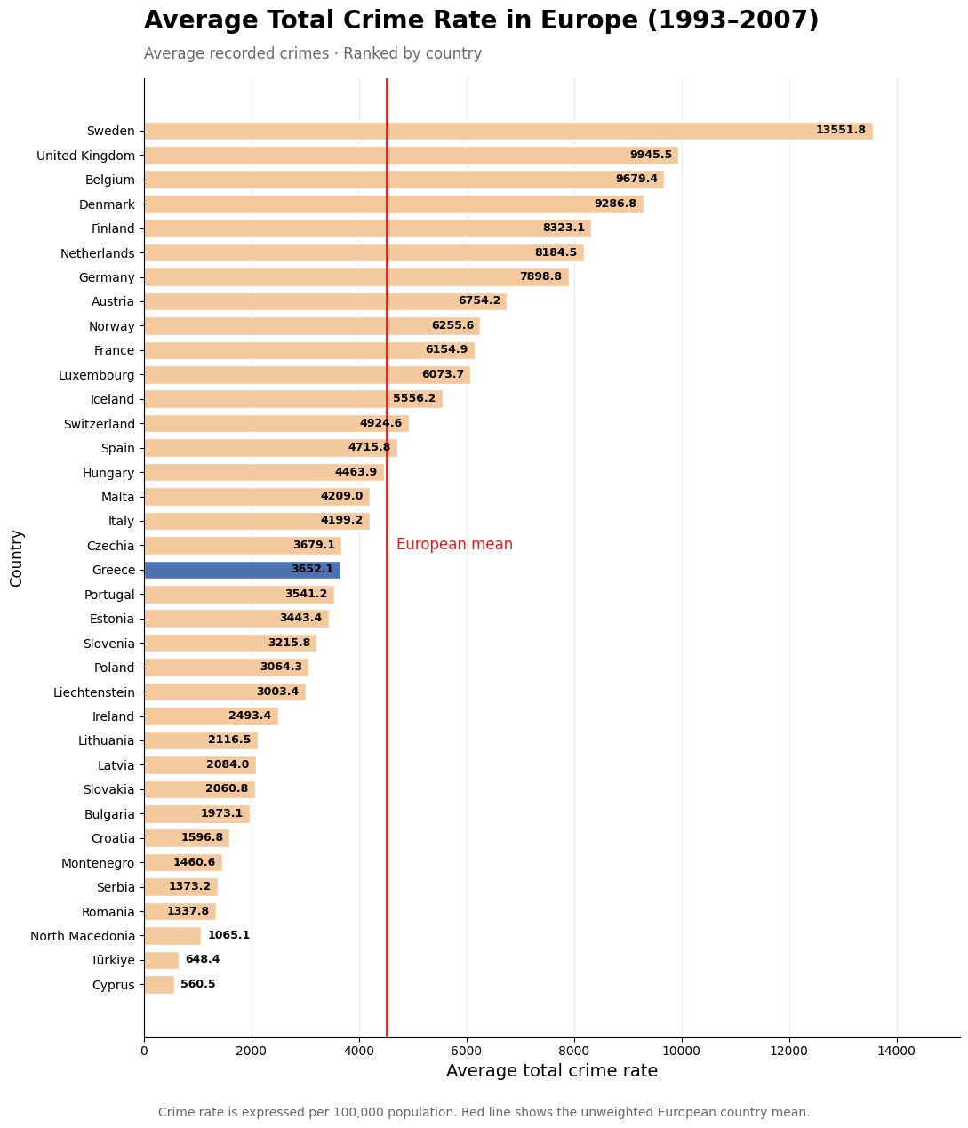
Average Total Crime Rate by Country
Greece had an average total crime rate of around 3,652 crimes per 100,000 inhabitants, below the European mean.
Greece ranked in the lower-middle range among European countries.
Countries such as Sweden, the United Kingdom and Belgium recorded much higher average crime rates during that period.

Slide 7
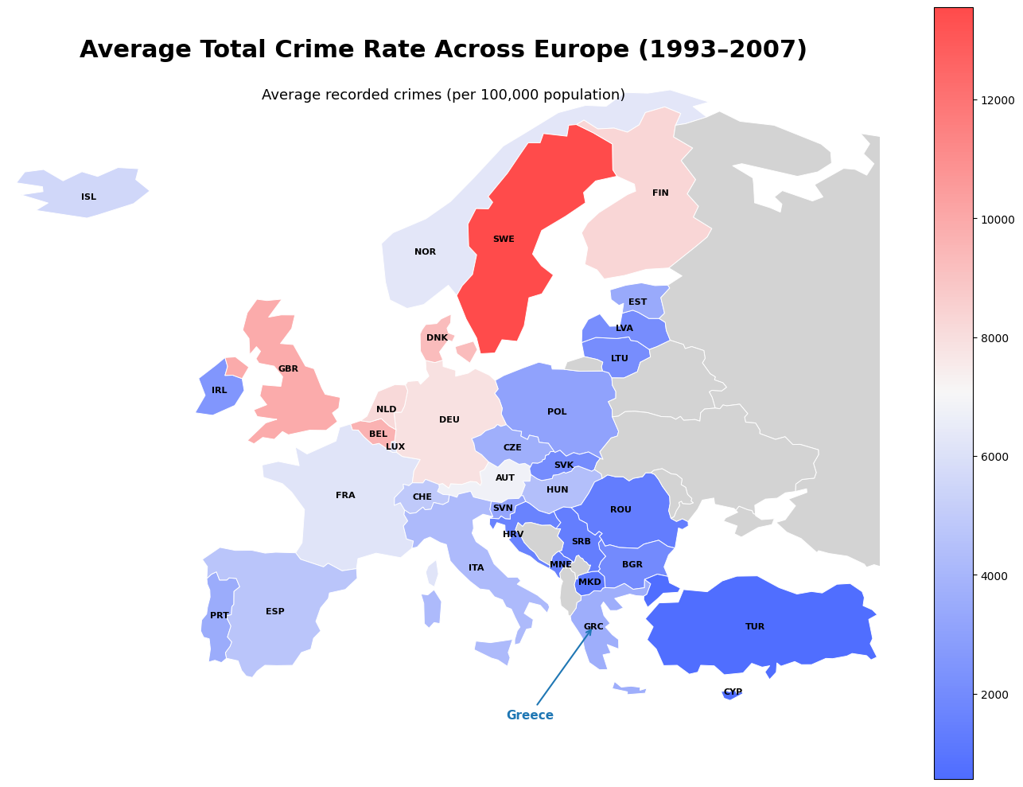
Spatial Variation in European Crime Rates
Higher average recorded crime rates appear mainly in Northern and Western Europe.
Greece is placed among the lower crime rate countries.
The geographic view indicates that Greece is below the European average.

Slide 8
Country-by-Country Rate Trajectories (Next Slide)
European countries did not follow one common trend between 1993 and 2007.
Greece followed a moderate trajectory, without extreme fluctuations.
Some countries remained at much higher recorded crime-rate levels, while others stayed consistently lower.

Slide 9
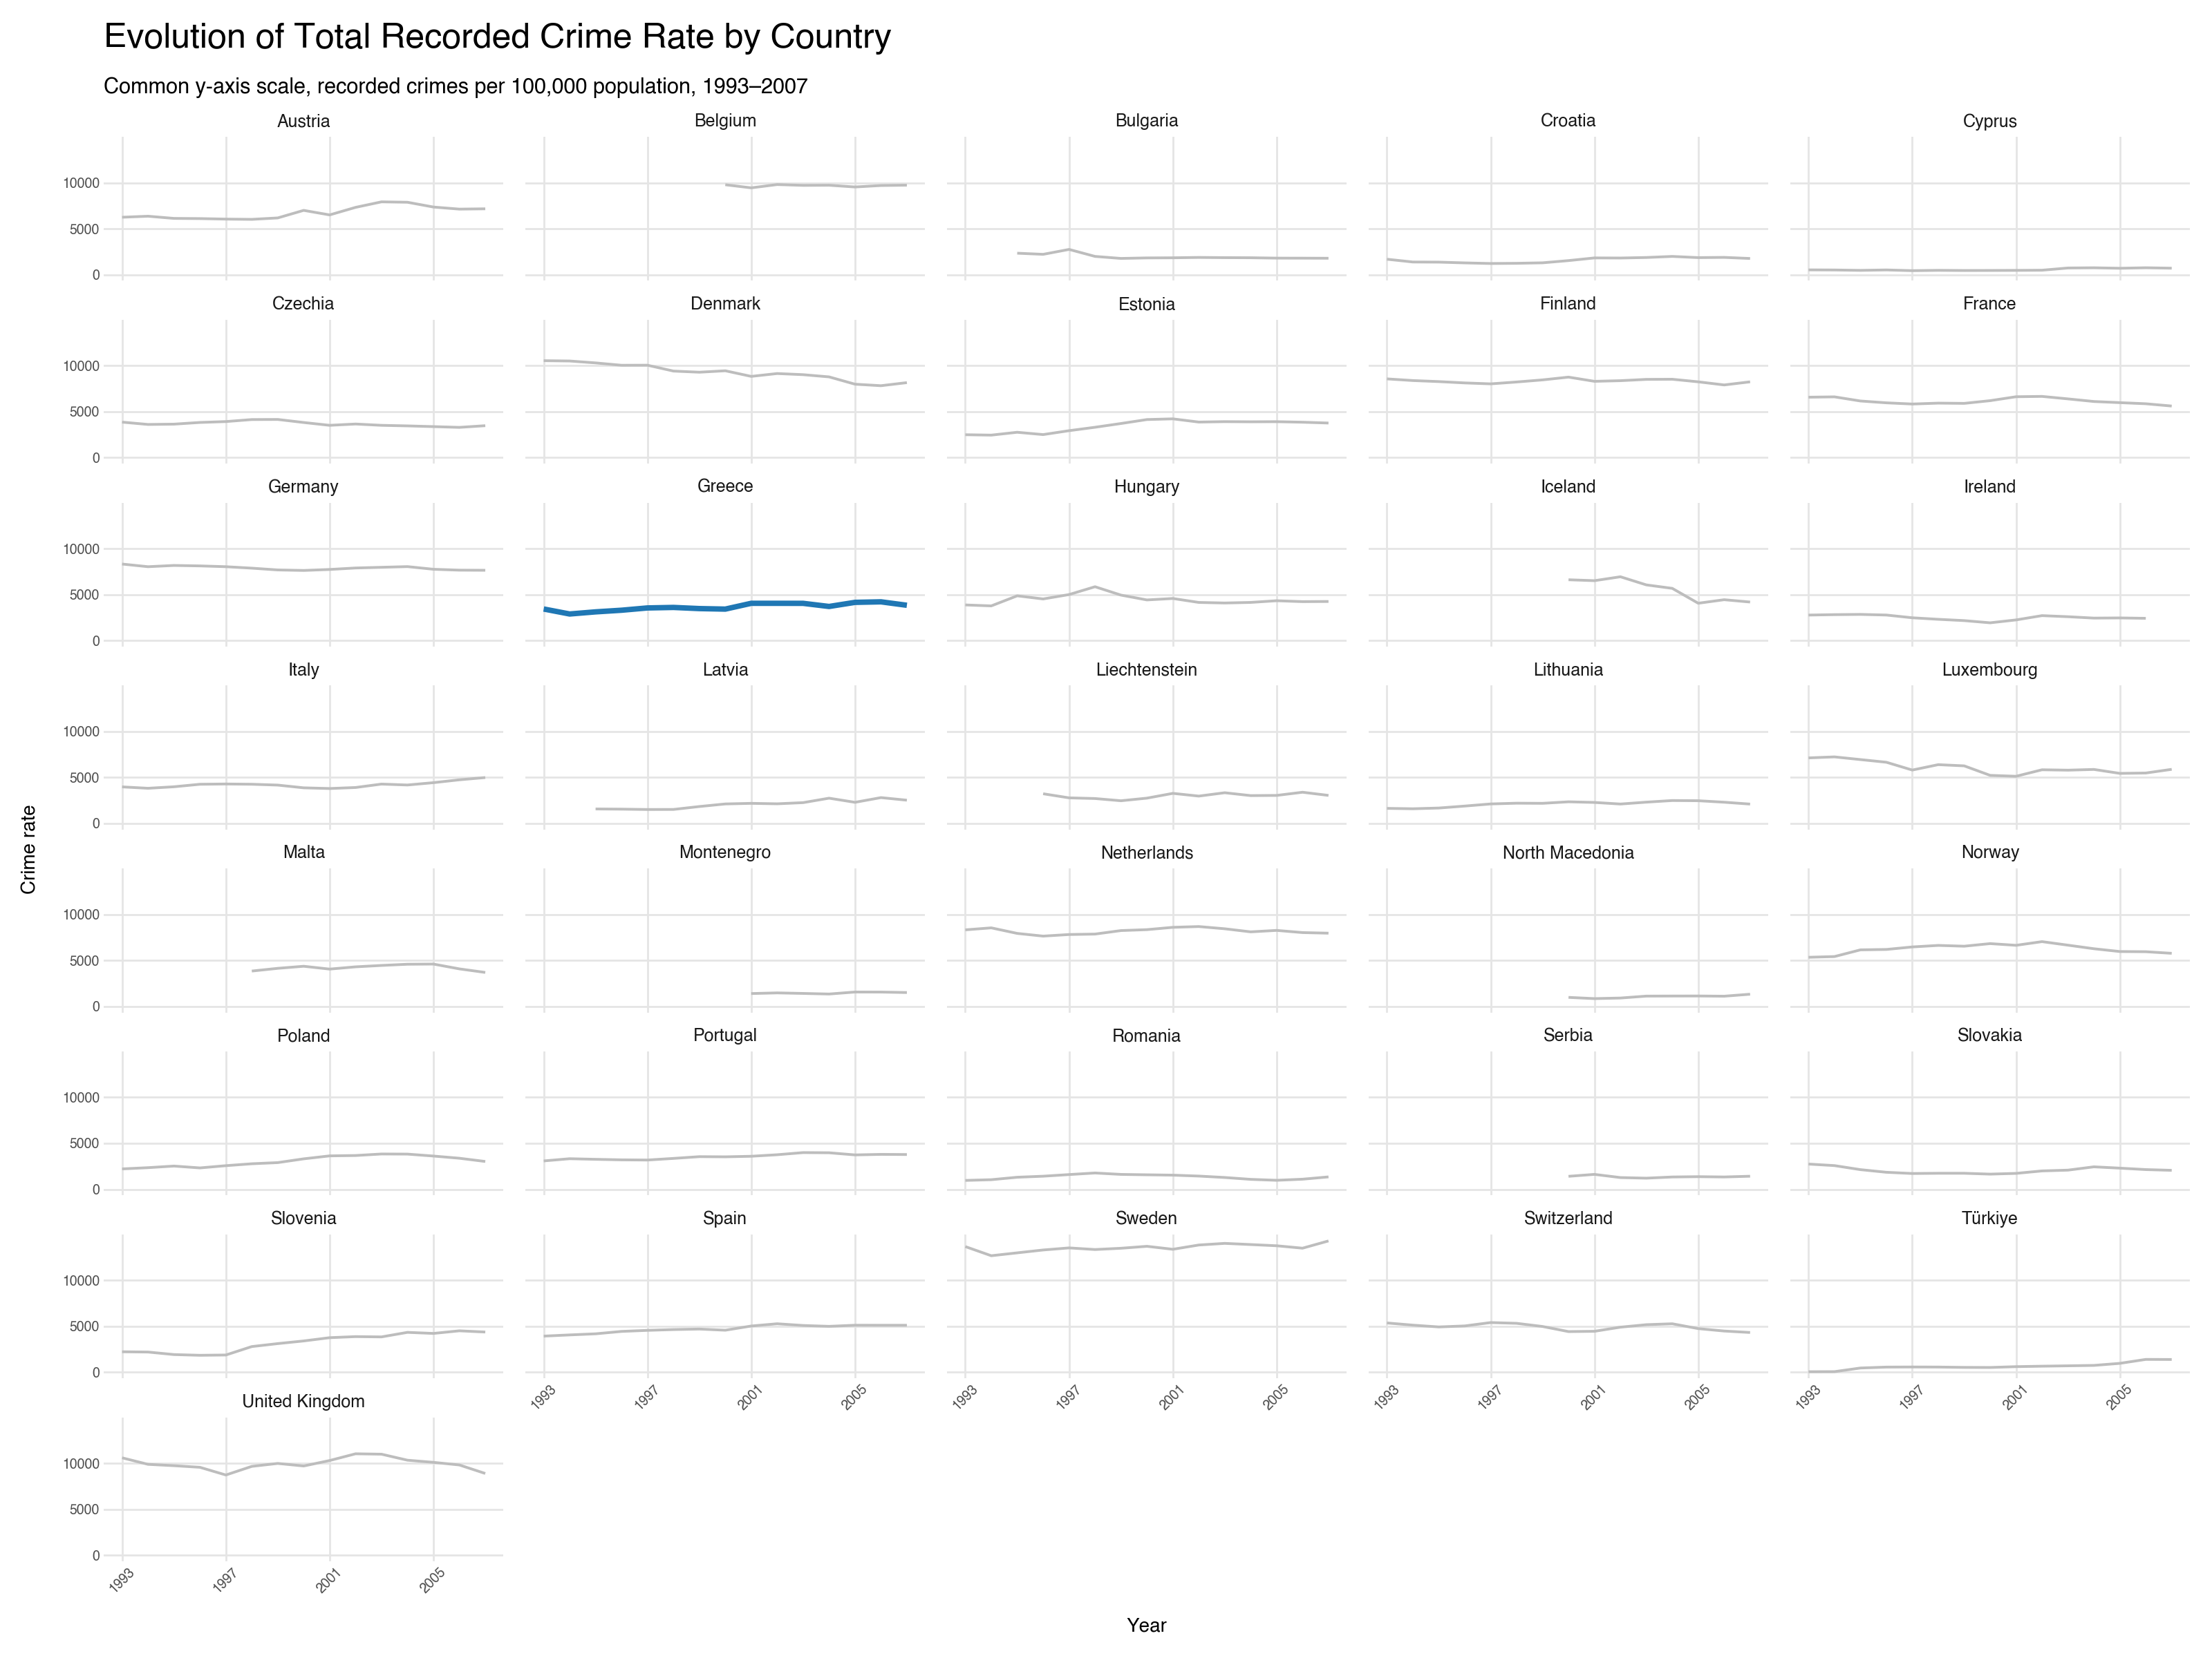

Slide 10
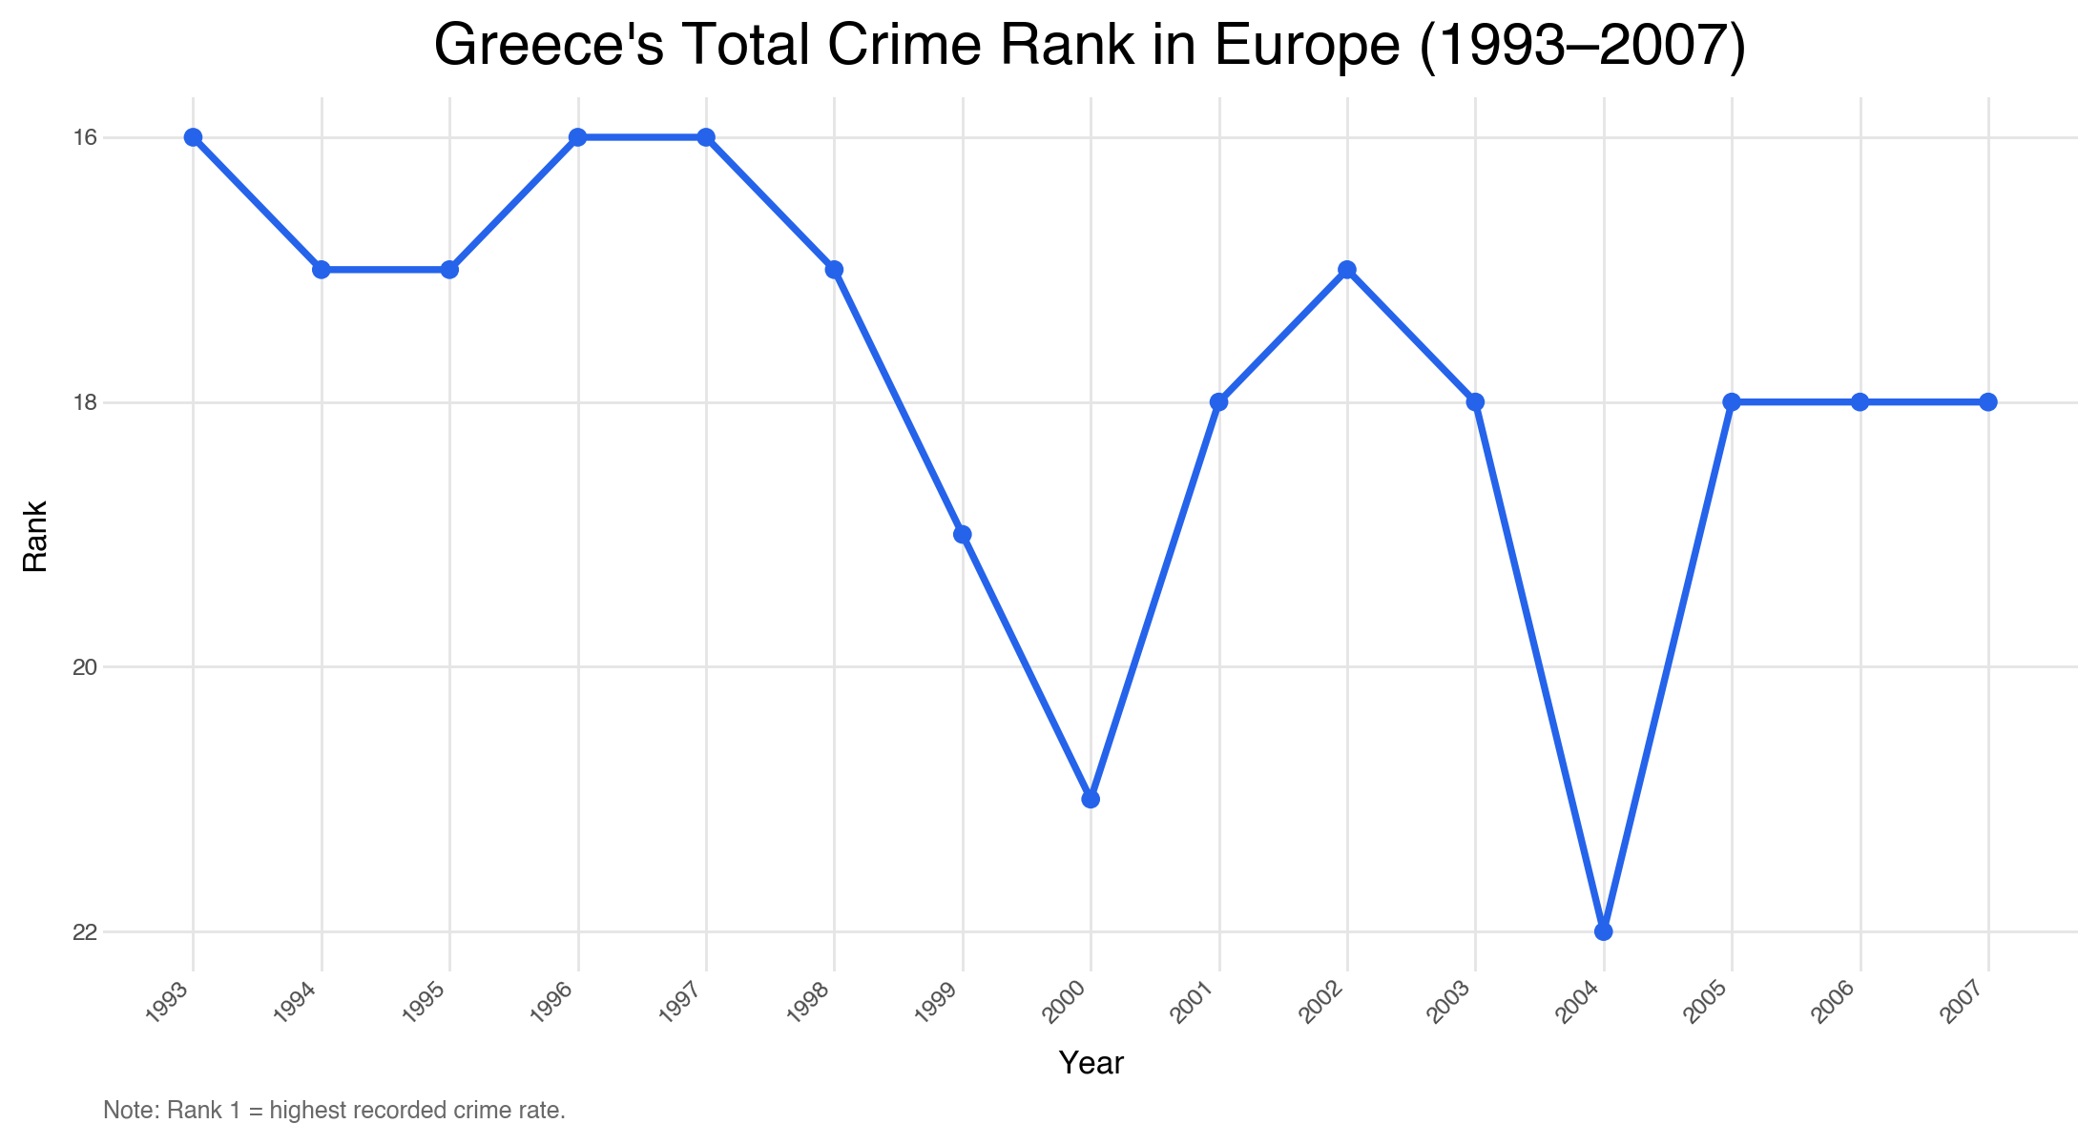
Greece’s Ranking Over Time
Greece stayed mostly in the middle range of the ranking.
Its position fluctuated over time, with lower ranking positions around 2000 and 2004.
Rank changes show relative position, not the absolute size of crime rates.
Notes:
Rank 1 = highest recorded crime rate

Slide 11
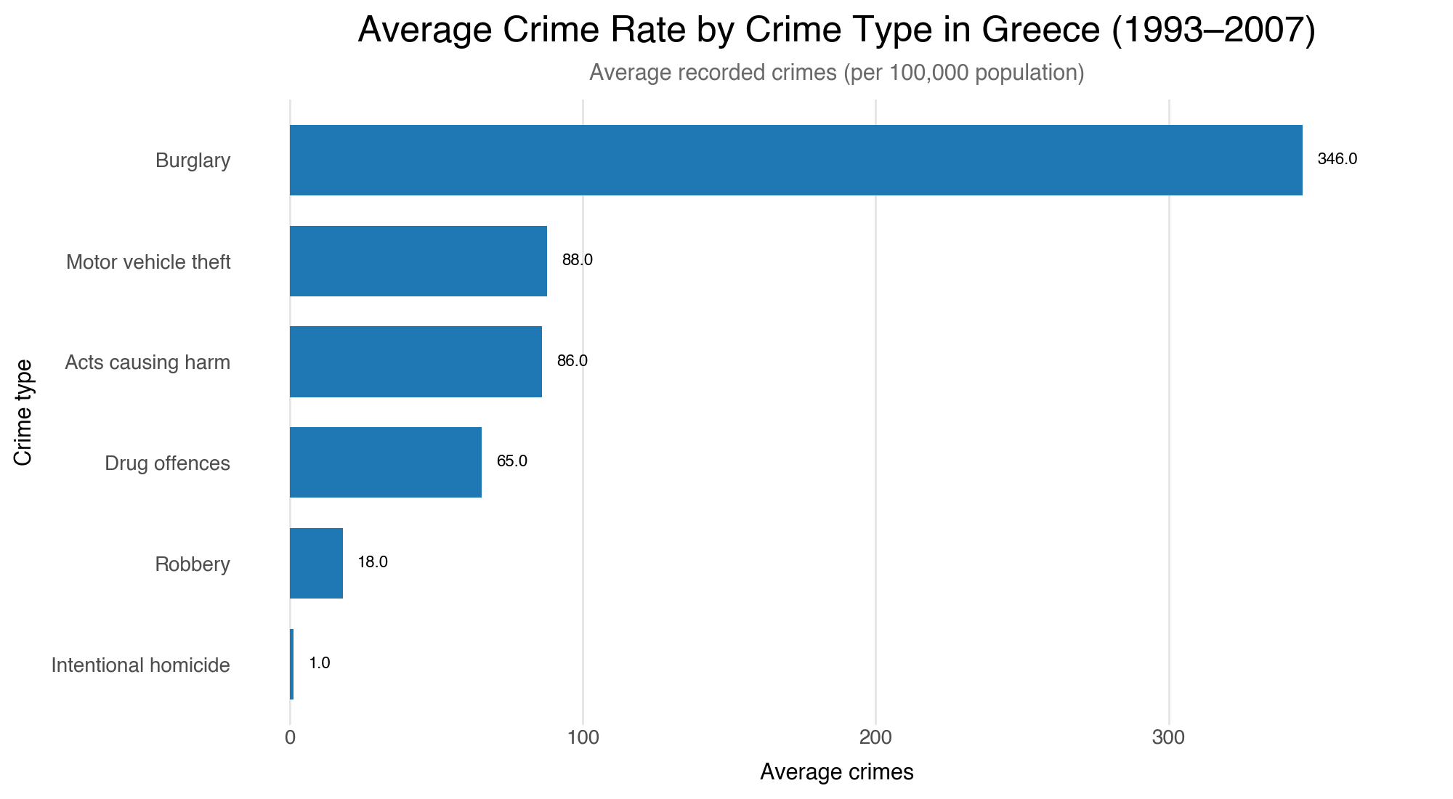
Crime Type Composition in Greece
Burglary was by far the most common recorded crime type in Greece during 1993-2007.
Motor vehicle theft and acts causing harm followed, but at much lower average rates.
Intentional homicide remained very low.

Slide 12
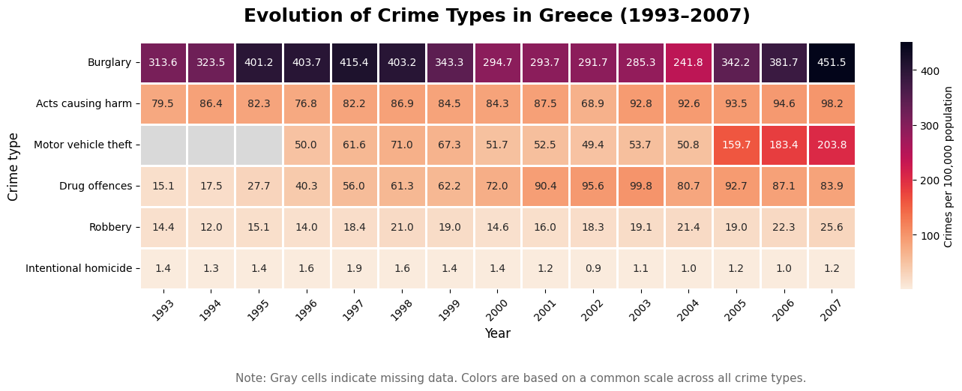
How Crime Types Evolved Over Time in Greece
This plot shows the same crime categories year by year, instead of only their average level.
Burglary was very high from 1995 to 1998, declined for several years, and increased again after 2005.
Drug offences showed a strong upward trend over the period.
Motor vehicle theft rose sharply after 2005, while intentional homicide stayed very low.

Slide 13
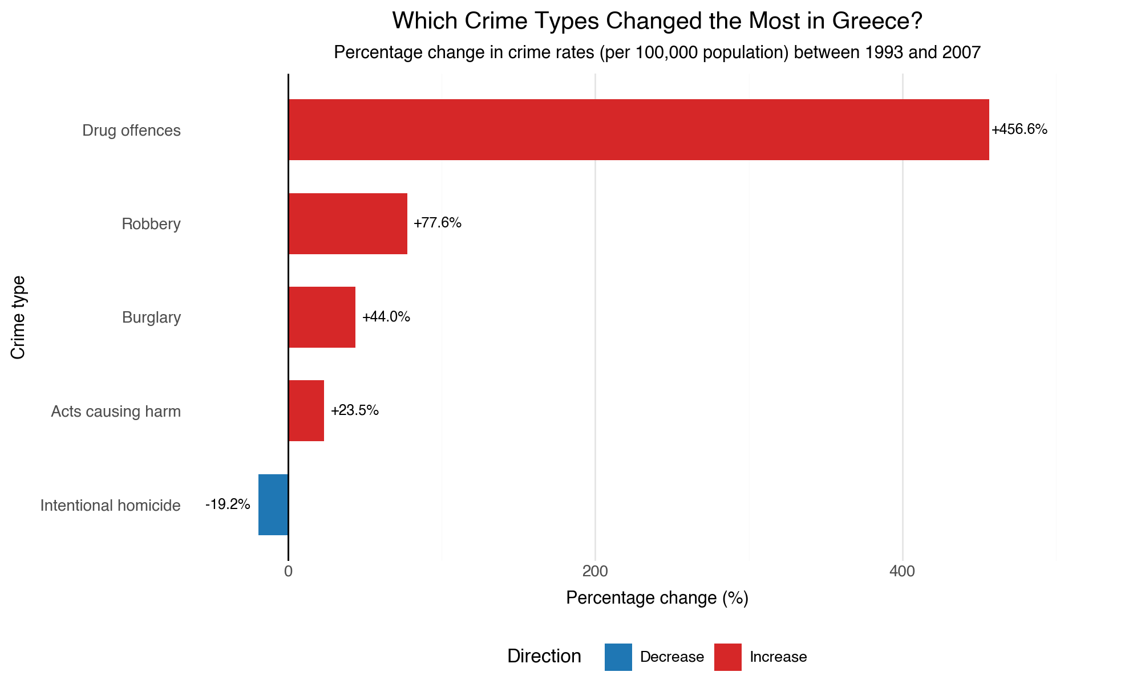
Largest Changes in Greece’s Crime Types
Drug offences had by far the largest increase, rising by more than 450% between 1993 and 2007.
Robbery and burglary also increased, but more moderately.
Intentional homicide was the only category that decreased.

Slide 14
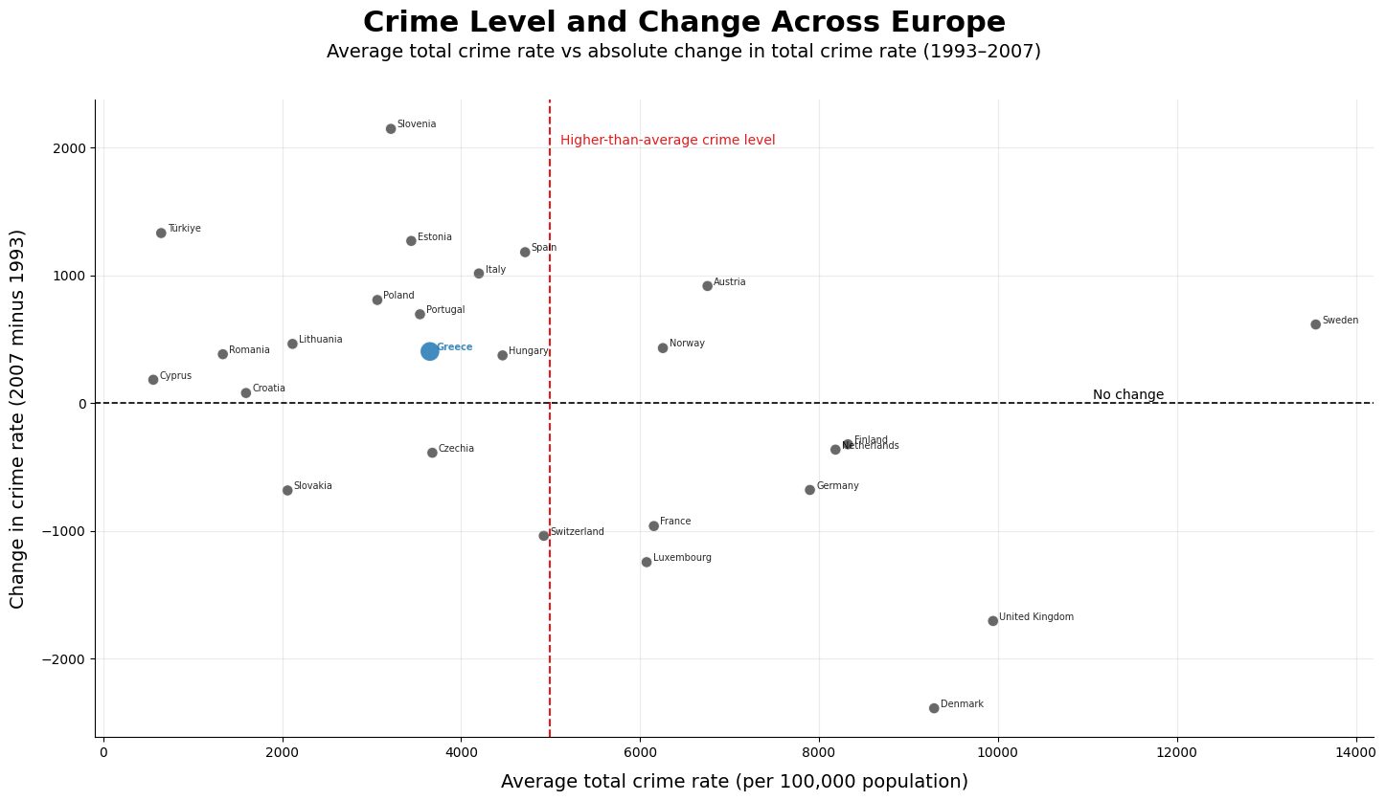
Crime Level vs Crime Change Across Europe
The x-axis shows each country’s average total crime rate, while the y-axis shows the change from 1993 to 2007.
Greece had a below-average crime level with a moderate increase.
Some high-crime countries, such as the United Kingdom and Denmark showed a decrease by 2007.

Slide 15
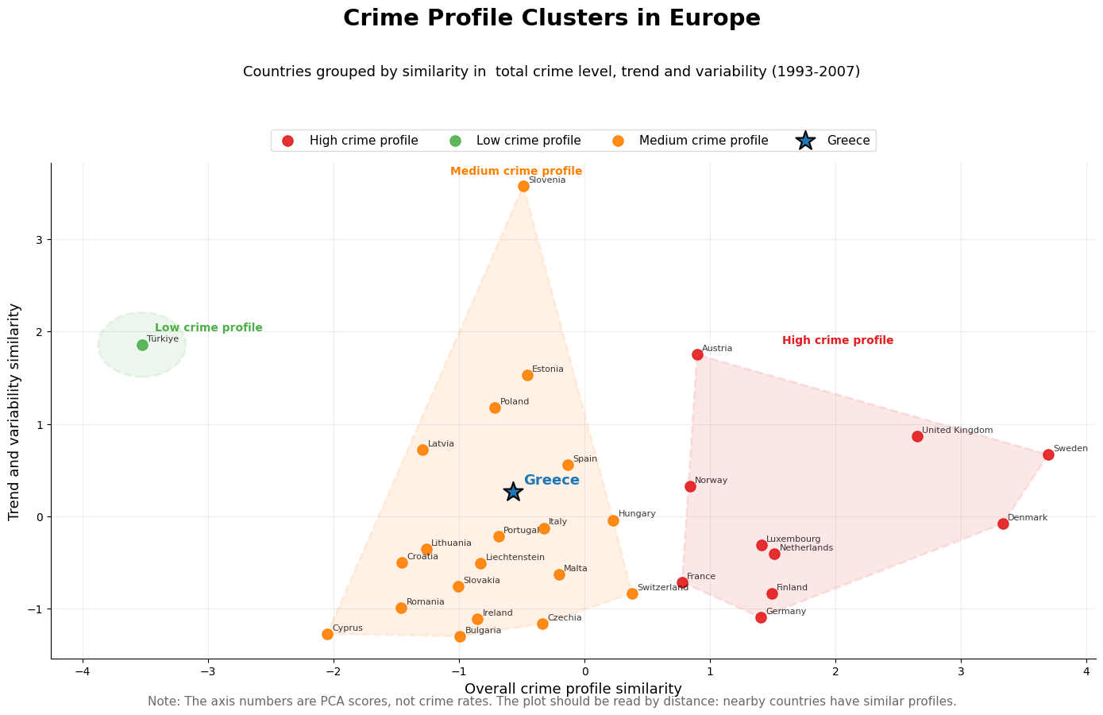
Grouping Countries by Crime Profile
Countries are grouped based on crime level, trend and variability during 1993-2007.
Greece belongs to the medium crime profile cluster.
The plot shows that Greece’s overall crime pattern is closer to medium-profile countries, not to the highest-crime cluster.

Slide 16
Main Conclusions
Greece remained below the European average in total recorded crime rate.
Greece was generally in the lower-middle range of European countries, not among the highest recorded crime-rate countries.
Within Greece, burglary was the most common recorded crime type.
Drug offences showed the strongest relative increase between 1993 and 2007.
Overall, Greece’s crime profile was closer to medium-profile European countries than to the highest-crime group.

Slide 17


